Slide 1
SMART CITY
RURAL vs CITY
BY TELECOM TIGER GROUP:
(alphabetically)
Yi Chen Anshu Jana
Xueting Liu Zizhe Liu
Zhengyu Pan Saurabh Pathare
Xiang Tan Tanomi Ujjwal

Slide 2
CONTENTS
PART ONE Introduction
♦ Project Objective
♦ Background introduction
♦ Issues in Rural areas
PART TWO Wireless Networks
♦ Issue
♦ Affected Group
♦ Solution
PART THREE Health Issues
♦ Issue
♦ Plans
PART FOUR Smart Watering
♦ Functions
♦ Benefits
♦ Technology
PART FIVE Conclusion

Slide 3
Part 1
INTRODUCTION

Slide 4
1.
Project Objectives
The initiative of this project is to come up with smart city solutions in order to decrease the rural and urban divide. A city becomes ‘smart’ when its features uplift the ease of living for all the citizens.
The following work aims to present three problems and their proposed solutions for the urban and rural areas.

Slide 5

2.
Issues in Rural Area
Wireless
Connection
Internet
Health Care
Health
Agriculture
Watering

Slide 6
Part 2
Wireless Network

Slide 7
1
ISSUE
Ignorance on mobile connection
Side-effect on “Unlimited”
Limited traffic type

Slide 8


2
Affected Group
Tourist
Resident
Rural business

Slide 9
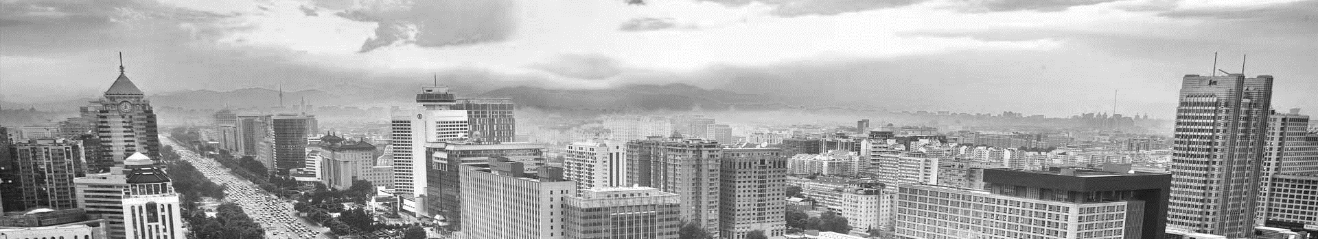
3
SOLUTION
Multiple Access Protocols with Smart Antennas in Multihop Ad Hoc
♦ Technology
♦ Business
♦ Policy

Slide 10
Part 3
HEALTH ISSUES

Slide 11
1
Issue
20% rural and remote areas
‘Digital divide’
E-medical Services
agricultural, manufacturing and mining industries
given people in urban areas an undue advantage
benefit rural people

Slide 12
2
Problem
Higher death rate due to shortage of medical practitioners in rural and urban areas.

Slide 13
3
Present Plans
Tele-Health &
e-Health
General Practice Rural Incentives Program：Modified Monash Model
Royal flying doctors service: aeromedical service – aviation medical service , telehealth, patient transfer
Rural Emergency Responders Network

Slide 14
4
Plans
Vendor machine
Make rural service mandatory during coursework for budding doctors
All practitioner plan: distance learning
Doctor/Hospital on wheels.

Slide 15
Part 4
SMART WATERING

Slide 16
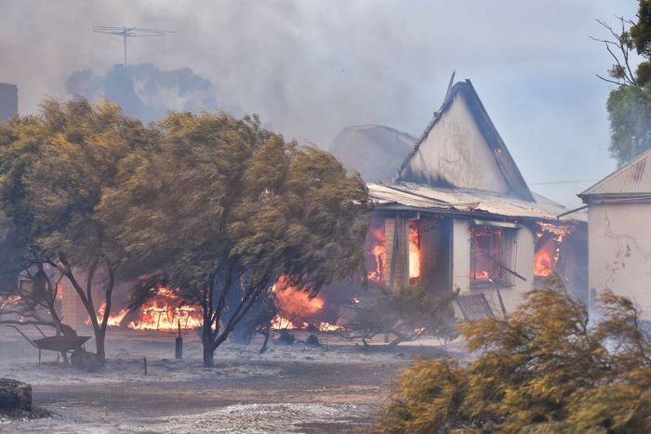
Fire in South Australia
The first multiple-area severe fire danger ratings of late 2017 have been issued for South Australia, more than a month before summer starts.
Severe fire danger ratings have been put in place for the Northwest Pastoral, West Coast, Eastern Eyre Peninsula, Flinders, Mid North, Mount Lofty Ranges and Riverland districts.

Slide 17
Helpful Solution ?

Slide 18
What is Smart Watering?
Smart Watering is an automated watering schedule that uses environmental information to ensure plants get the optimum amount of water. Evaporation will draw moisture from your garden, while rainfall and irrigation will add moisture.

Slide 19
1
Functions
Smart irrigation
Smart sprinkler for play ground and garden
Smart sprinkler for fire

Slide 20
Brisbane Smart Watering City---for playground
New digital irrigation monitoring systems are being progressively installed each year.
The system sees water monitoring devices digitally linked to weather stations and installed to monitor and report water flow, usage trends and environmental data, enabling clubs to better manage their water usage on sports fields and improve their playing surfaces.

Slide 21
Rachio City &Rural---fire prevention
Protect your property and neighbors with Rachio by using your sprinklers to mitigate fire spread. A Rachio Smart Sprinkler Controller will automatically cycle through your sprinkler zones if Nest Protect detects smoke inside your home. The moistened lawn will serve as a barrier, slowing and helping prevent the spread of fire across property lines.

Slide 22
Skydrop: City &Rural---fire prevention
With a Nest Protect, we already have an integration to have each of the zones run the sprinklers run for a short duration in the event of a fire. But, let’s say you have an Ecobee Thermostat, if the thermostats indoor temperature is greater than 120 degrees there is likely a fire. With IFTTT and Skydrop you can trigger a notification and have each of the zones run briefly for fire containment

Slide 23
2
Benefit
Save money and water resource
Provide fire alarm and cooling system

Slide 24
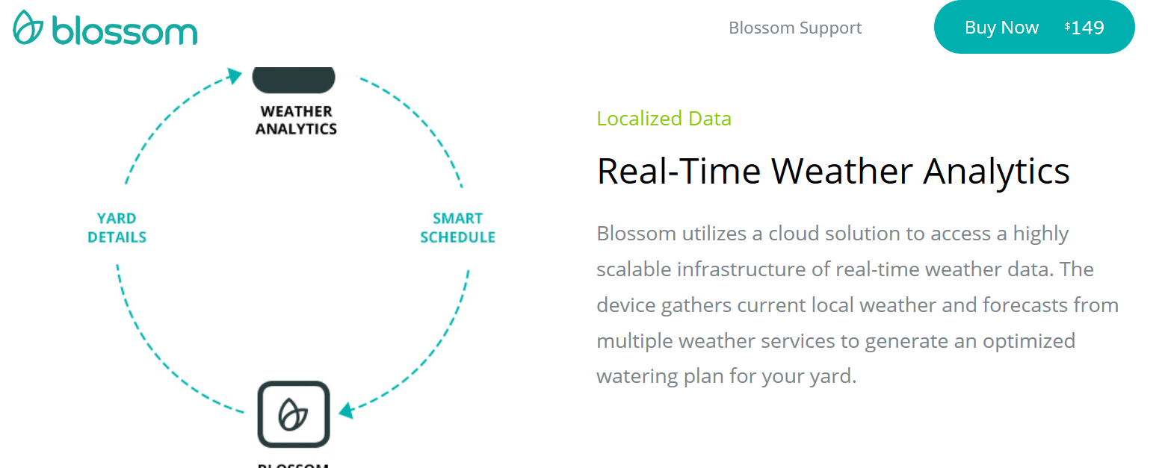
3
Technology

Slide 25
Area of Usage
Benefit
It can be applied to a place as close and easy like the garden and can be applied in rural and city areas. Smart Watering can be applied to Australia. It’s too hot in South during summers and sometimes causes fire. The temperatures reach up to 46 degrees C and there is a looming water crisis also. Adelaide is the fifth hottest city in Australia.
Calculate the evapotranspiration loss, which occurs since the last irrigation cycle; Control each sprinkler head relative to the quantity of water applied and the duration of the application, to replace the lost water; Apply water at a rate that will prevent runoff; Regulate pressure at each head to get maximum uniformity of water distribution; Allow the field staff to make site adjustments to compensate for shade, slope, sun exposure (relief), etc.
Cost
Value: Save water
prevent fires
A professionally installed system for a typical ¼-acre lot is $3,000 to $4,000. You can DIY it for under $1,500. But there is good return on investment in 1-5 years depending on water costs and current irrigation practices.
Delivering the right amount of water at the right time. Save time: Automates the work needed to maintain a healthy landscape, reducing manual effort. Save money: With water scarcity increasing and prices rising, it can save money.
A Rachio Smart Sprinkler Controller will automatically cycle through your sprinkler zones if Nest Protect detects smoke inside your home. The moistened lawn will serve as a barrier, slowing and helping prevent the spread of fire across property lines.

Slide 26
Central control, weather-based information from weather stations, flow sensing capabilities, and two-way radio and wireless technology will make the future of landscape irrigation greener for all. As with many industries, the power of the Internet combined with ubiquitous wireless communication devices like cell phones, pagers, etc. are propelling these changes.
In the Sunbelt states, e.g., Texas, California, and particularly those states with large agricultural communities like the San Joaquin Valley, water is one of the most precious resources available. While agriculture is a major user, large volumes of water are also funneled to large metropolitan areas such as Los Angeles, CA.
The biggest advances in irrigation technology are emerging within irrigation system controllers – the brain of the system. Controllers have evolved from motorized, master hydraulic valves that powered a series of pressurized valves to electromechanical clocks and, most recently, to microcomputer-based clocks. As the concept of on-site remote control evolves, the use of GPS satellite, fiber optics or modem, and new system control models that can connect any wireless or Internet-enabled device to the brain of the irrigation system are emerging. In this way, contractors could use a computer in their office to run, test and troubleshoot hundreds of different sites. Not only that, similar to systems already in use on golf courses, centralized controllers can be connected to a weather station to monitor natural precipitation, ET rates, temperature and wind in order to make adjustments to the irrigation programs at individual sites.

Slide 27
Conclusion
Conclusion

Slide 28
Smart city solutions like Smart watering, digitalized healthcare system and improved wireless connectivity aim to improve the living standards of both the urban and rural citizens.
The value configuration of smart city includes the proposed ideas at desired levels.
An improved wireless connectivity will enable people to be connected from places that currently have less network. Smart watering solutions with the help of real-time weather analytics will help in the city’s economy by cutting now on use of water and money. Digitalized health care system will provide access to better and quicker health care to people from rural areas, which will in turn also boost the population of the area.

Slide 29
THANK YOU
FOR WATCHING
THANK YOU
FOR WATCHING
THANK YOU
FOR WATCHING
THANK YOU
FOR WATCHING

